Slide 1
Unauditable Governments
Subtitle
Scott Nelson
Director of Legislative and Policy Affairs
Kelly Collins
Director of Local Audit
December 1, 2020

Slide 2
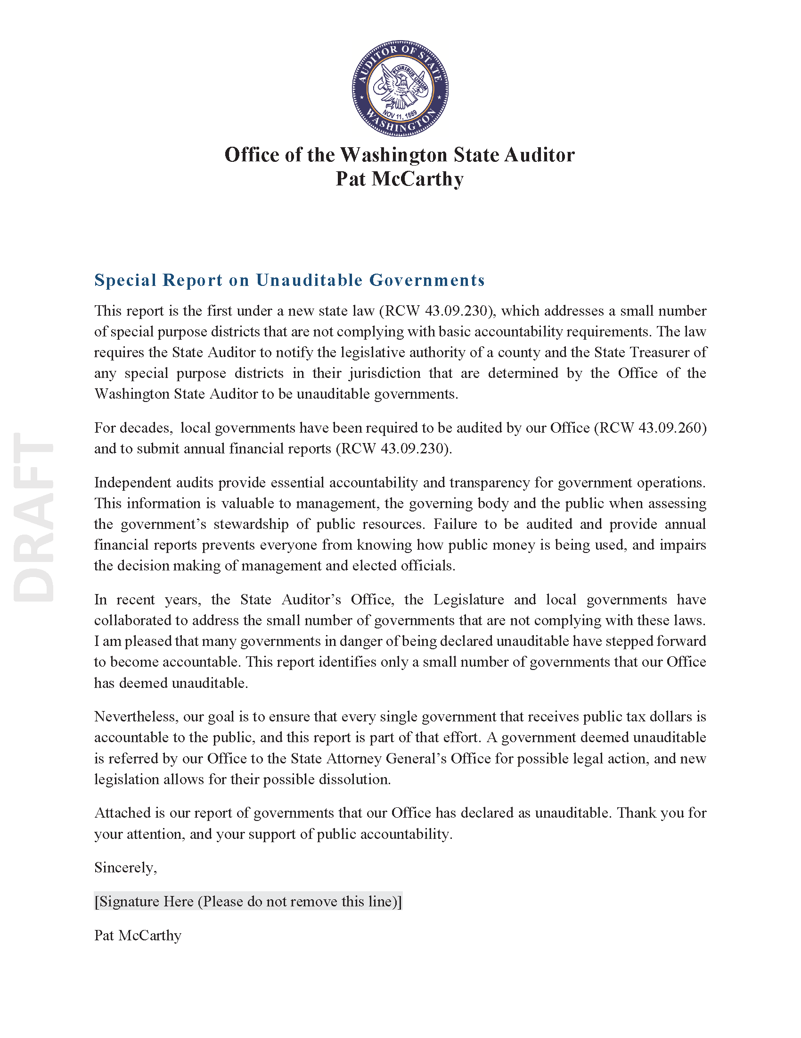
Special Report to Legislature
A blank canvas
DRAFT
Notes:
This draft report, which is scheduled to publish at the end of December, is the first under the new state law addressing a small number of special purpose districts that are not meeting basic accountability requirements.
The law requires the State Auditor’s Office to notify a county’s legislative authority and the State Treasurer of any such district in their jurisdiction that it deems to be unauditable.

Slide 3
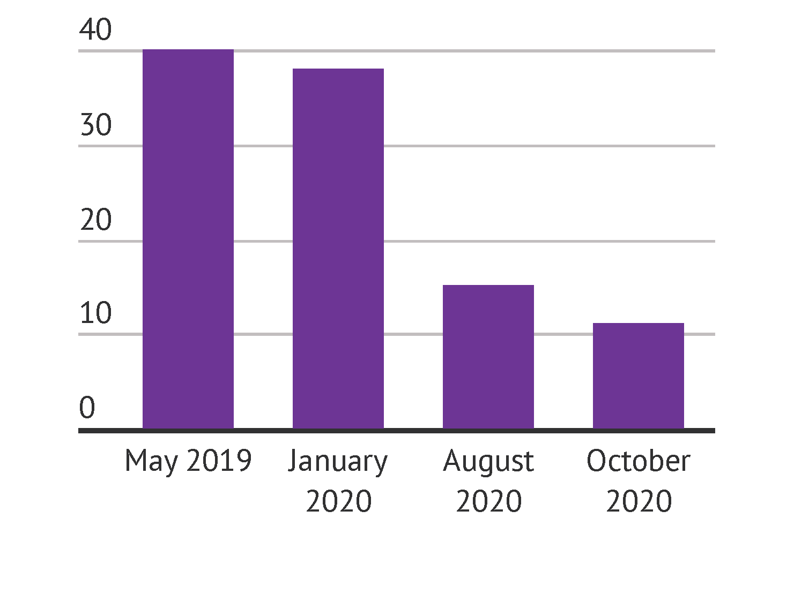
Number of Unauditable Governments
Notes:
This table shows the governments that have received reports declaring them an unauditable government as of fiscal year end 2020.
However, by the time this report publishes at the end of December, we expect up to 4 more governments to be added to this list.

Slide 4
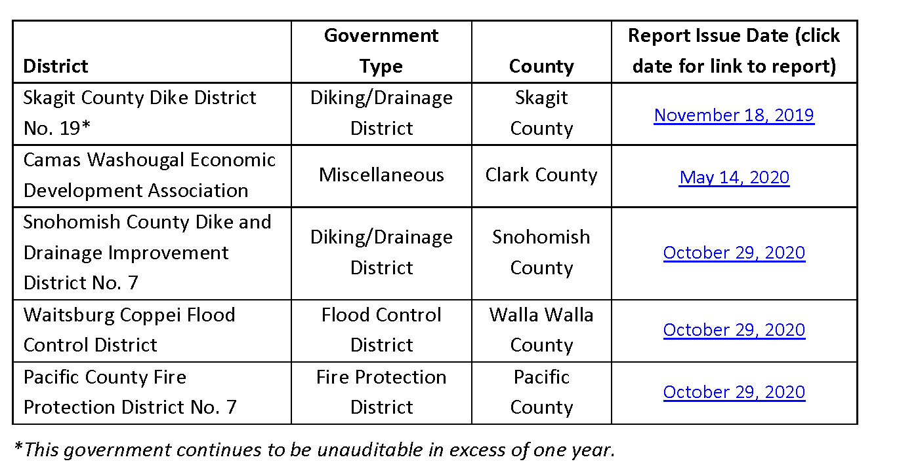
Unauditable Governments List
DRAFT
Notes:
This table shows the governments that have received reports declaring them an unauditable government as of fiscal year end 2020.
Skagit County Dike and Drainage District No. 19 is making efforts toward resolution.
However, by the time this report publishes at the end of December, we expect up to 3 or 4 more governments to be added to this list.

Slide 5
Information
  Scott Nelson, Director of Legislative and Policy Affairs
  nelsons@sao.wa.gov
  (564) 999-0804
  Kelly Collins, Director of Local Audit
  collinsk@sao.wa.gov
  (564) 999-0807
Website: www.sao.wa.gov
Twitter: @WAStateAuditor
Facebook: www.facebook.com/WAStateAuditorsOffice
LinkedIn: Washington State Auditor’s Office

